Slide 1
Memory Management Week 3
Dr. Pierpaolo Dondio,
DT228A/ADS

Slide 2
Memory Management
Stack and Heap, Dynamic and Static Scope, Garbage Collection

Slide 3
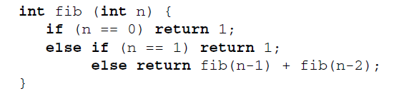
Memory Management
Static versus dynamic
Recursive functions vs loops
Stack vs Heap

Slide 4
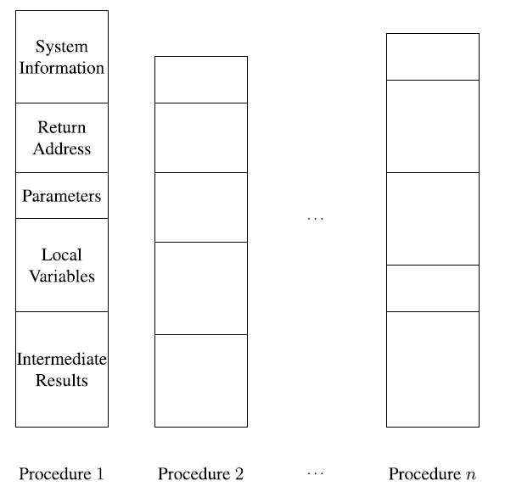
Static Memory management
Each procedure is allocated before runtime
One memory location for each procedure, but variable

Slide 5
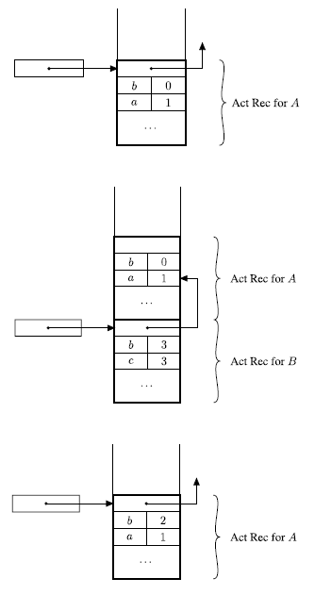
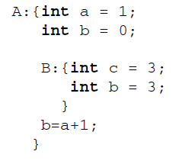
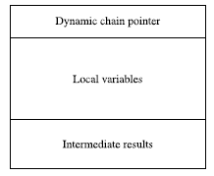
Dynamic Memory Management
Stack (LIFO)
Activation Record (for inline blocks or procedure)
Inline blocks: dynamic chain pointer, local variables, intermediate results
Note the variable hiding

Slide 6


Example of inline blocks
Sometime intermediate values need to be store
They are stored in the activation record
Variable of fixed length? Example of arrays

Slide 7
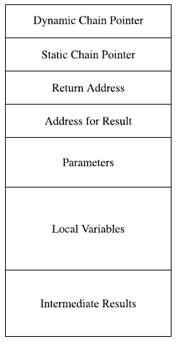
Activation Record for a Procedure
Intermediate results, local variables, dynamic chain pointer The same as for in-line blocks.
Static chain pointer This stores the information needed to implement the static
Return address Contains the address of the first instruction to execute after the call to the current procedure/function has terminated execution.
Returned result Present only in functions. Contains the address of the memory location where the subprogram stores the value to be returned by the function when it terminates. This memory location is inside the caller’s activation record.
Parameters The values of actual parameters used to call the procedure or function are stored here.
Offset, Registers used as well

Slide 8
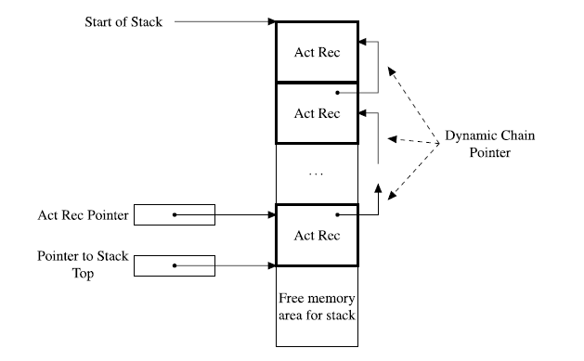
When a procedure is called /1
Modification of program counter This is clearly necessary to pass control to the called procedure. The old value (incremented) must be saved to maintain the return address.
Allocation of stack space The space for the new activation record must be pre-allocated and therefore the pointer to the first free location on the stack must be updated as a consequence.
Modification of activation record pointer The pointer must point to the new activation record for the called procedure; the activation record will have been pushed onto the stack.

Slide 9
When a procedure is called /2
Parameter passing This activity is usually performed by the caller, given that different calls of the same procedure can have different parameters.
Register save Values for control processing, typically stored in registers, must be saved. This is the case, for example, with the old activation record pointer which is saved as a pointer in the dynamic chain.
Execution of initialisation code Some languages require explicit constructs to initialise some items stored in the new activation record.

Slide 10
When a procedure is finished
Update of program counter
Value return. the value calculated by the function, must be stored in appropriate locations usually present in the caller’s activation record and accessible to the activation record of the called procedure.
Return of registers The value of previously saved registers must be restored. In particular, the old value of the activation record pointer must be restored.
Execution of finalisation code
Deallocation of stack space The activation record of the procedure which has terminated

Slide 11
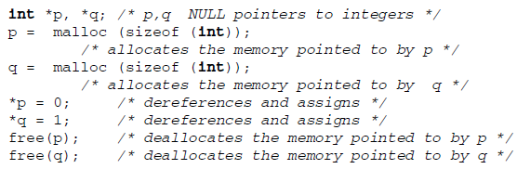
Dynamic Management Using a Heap
Why pointers cannot always go on the stack
Heap is not ordered
Fixed and Variable Length block

Slide 12
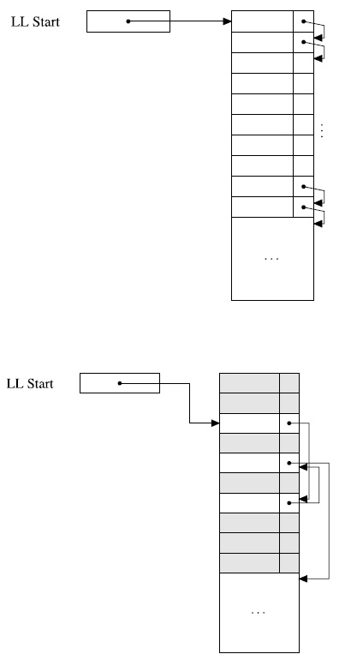
Fixed Length
Each block has a fixed length
Free List of blocks are stored as a linked list
The used memory grows downwards
Problem of internal fragmentation

Slide 13
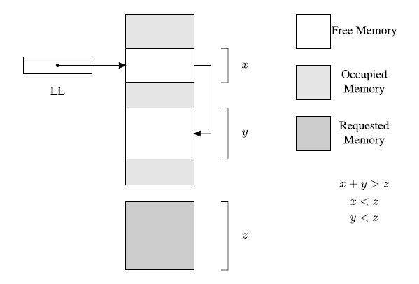
Variable Length
The idea is to use memory space better
Internal fragmentation removed
External Fragmentation
Need to compact free memory once deallocated

Slide 14
Variable Length
First fill all the heap
No segmentation on the heap
When the heap is full
First fit
Best fit
Difference?
Compacting contiguous free blocks
Partial vs total
Pointers?

Slide 15
Multiple free lists
More than one free list used
Each of them keeping blocks of different size
Dynamic
Buddy system
Search for the block
If not found chose the father (double)
Split it
Add the unused part to the son lists
When free look for a buddy
Fibonacci system

Slide 16
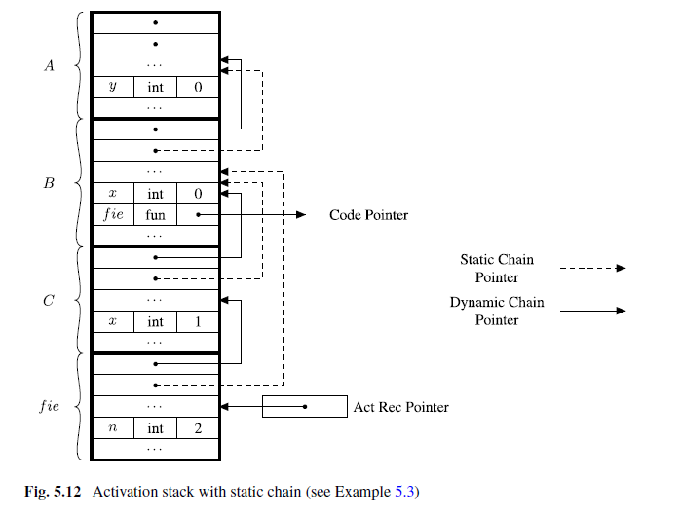
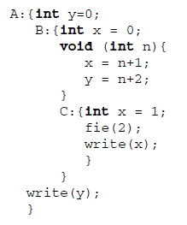
Static Chain Pointers
It follows the nested structure of the blocks

Slide 17
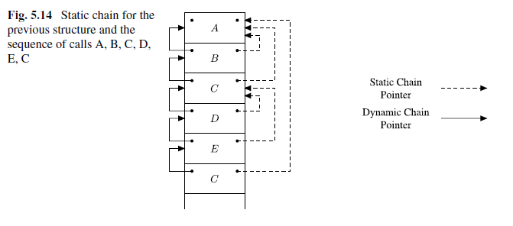
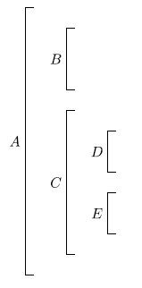
Static Chain Example
Static Chain Example.
Blocks entered in the following sequence: A,B,C,D,E,C
How does the stack look like?
Called outside the caller / Called inside the caller block

Slide 18
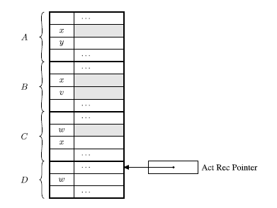
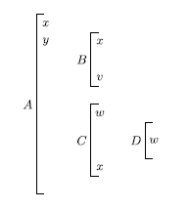
Dynamic Scope

Slide 19

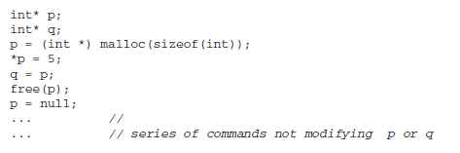




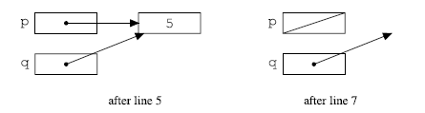
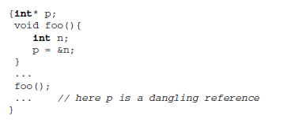
More on Pointers and memory
Deallocation
Dangling reference

Slide 20
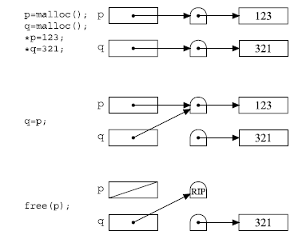
Avoiding Dangling references: Tombstone
Implicit / Explicit
Tombstone
When a pointer is created another pointer (tombstone) is set in the middle
Pointer q points to the tombstone first
When p is deallocated, the tombstone is deallocated
Cemetery – memory area storing tombstones
Heavy cost (storage), creation, checking, double referencing
Stored on the heap, if small data than many tombstones
Cannot reuse tombstone

Slide 21
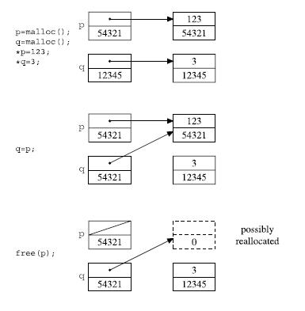
Locks and Keys
When a pointer is created, an incremental ID is added to the pointer (key) and then added to the pointed object (once allocated) – lock
When q=p the key is overwritten with the lock value
If p is destroyed, the lock is set to zero
The abstract machine checks if the keys open the locks
Possible reallocated – problem?
Statistically improbable
Costly – 2 words, double checking

Slide 22
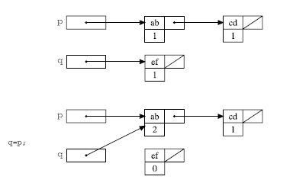
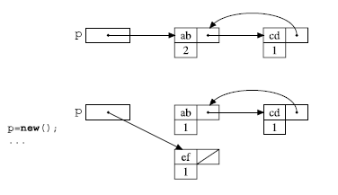
Garbage Collection - Counting
The free memory should be reused
Two phases: detection and collection
First solution: counting added to the created object
Plus: interleaved to normal operations
Not efficient, overhead especially for short-living data
Circular references

Slide 23
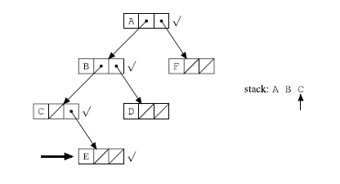
Mark and Sweep
First algorithm to be implemented
The objects that a program can access directly are those objects which are referenced by local variables on the processor stack as well as by any static variables that refer to objects. In the context of garbage collection, these variables are called the roots . An object is indirectly accessible if it is referenced by a field in some other (directly or indirectly) accessible object. An accessible object is said to be live .
for each root variable r
mark (r);
sweep ();
void mark (Object p)
if (!p.marked)
p.marked = true;
for each Object q referenced by p
mark (q);
void sweep ()
for each Object p in the heap
if (p.marked) p.marked = false else heap.release (p);
A stack is needed to traverse the data structure

Slide 24
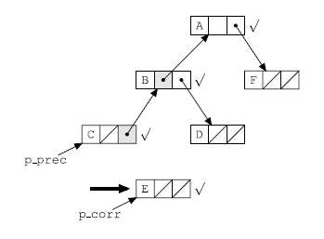
Need Reversal pointer
.. To traverse tree-like structures

Slide 25
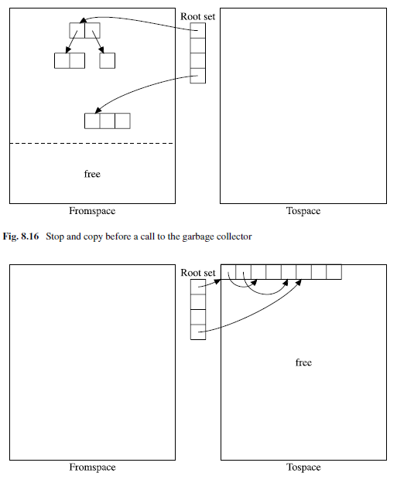
Mark and Copy
Heap divided in two equal parts
Only half is active
Allocation very efficient
When space is over:
Copy all the active structure on the other half-space
Swap the half space
Quite efficient
Increasing the size will decrise the copy operations
Proportional to the amount of used data – usually proportional

Slide 26
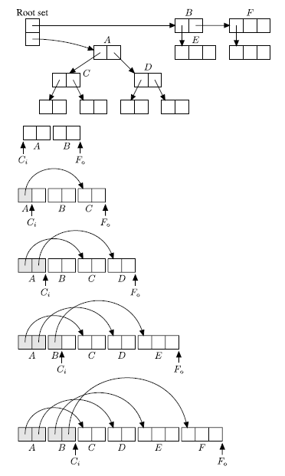
Cheney’s algorithm
Used to store data structure that are used by the program (accessible) in the mark and copy algorithm

